Slide 1
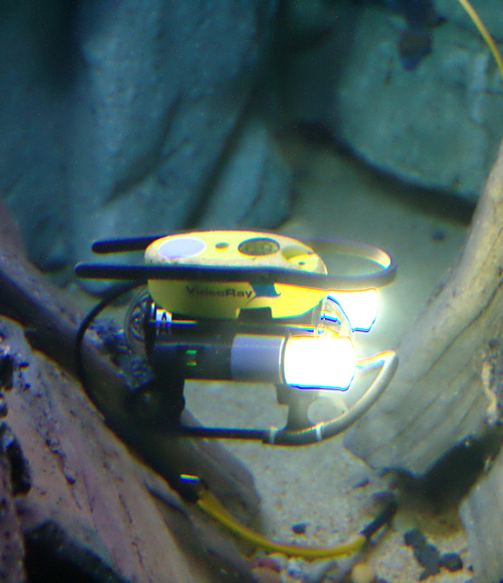
HydroLens
Hydro Lens: Advancing Maritime Surface Platforms with an Underwater Free-Moving Probe for Enhanced Search and Surveillance
Zeroth Review Presentation
Industry mentor:
Mohammed Mohideen
CEO&CO-FOUNDER OF DENVIK
Project Mentor:
Presented by:
Dr. C. Tharini
Professor & Dean (SECS)
MANAVENDRA .A
VENKATESH S
SHANMUGANATHAN . J
This Photo by Unknown Author is licensed under CC BY

Slide 2
CONTEXT
TITLE
ABSTRACT
INTRODUCTION
LITERATURE SURVEY
EXISTING AND PROPOSED SYSTEM
WORK PLAN
TIMELINE
WORK DISTRIBUTION AMONG TEAM MEMBERS
OUTCOME OF THE PROJECT
REFERENCE

Slide 3
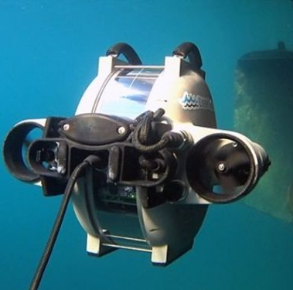
Objective
1.The device is used by shipyard companies and ports to inspect the quality of the keel(bottom part of the ship).
2.The device is used by ICG ships for underwater search like bodies, debris of aircraft and vessels.
3. To monitor aquaculture water quality parameters and cage netting inspection through load sensors.
This Photo by Unknown Author is licensed under CC BY-NC
Notes:
© Copyright Showeet.com – Free PowerPoint Templates

Slide 4
ABSTRACT
Remotely operated vehicles (ROVs) are underwater robots that are controlled remotely by an operator on the surface. These ROVs are connected to the operator through a series of wires that transmit signals. The underwater vehicle is designed to work instead of human beings because there is a risk to use human beings to moniter in a difficult to reach and hazardous areas. Human explorer performance under water are limited. Thus, a dedicated tool or device such as a Remotely Operated Underwater Vehicle (ROV) is required in helping human to perform these keel maintenance and search activities. The vehicle equips with powerful underwater probe sensors to collect underwater data, dc brush less motor for controlling direction as well as real time camera monitoring. It transmits video data and perform an automated drive. The data is sent via underwater cable to computers base station on the coast. The tilt control, achieve pitch stability and perform underwater observation through a video camera where surge control is by joystick operated control mechanism. The tools used in the developing process is processing program for GUI and microcontroller (Raspberry pi) for reading and controlling all sensors data such as accelerometer ,gyro meter and motor speed control in order to keep the vehicle stabilizer movement.

Slide 5
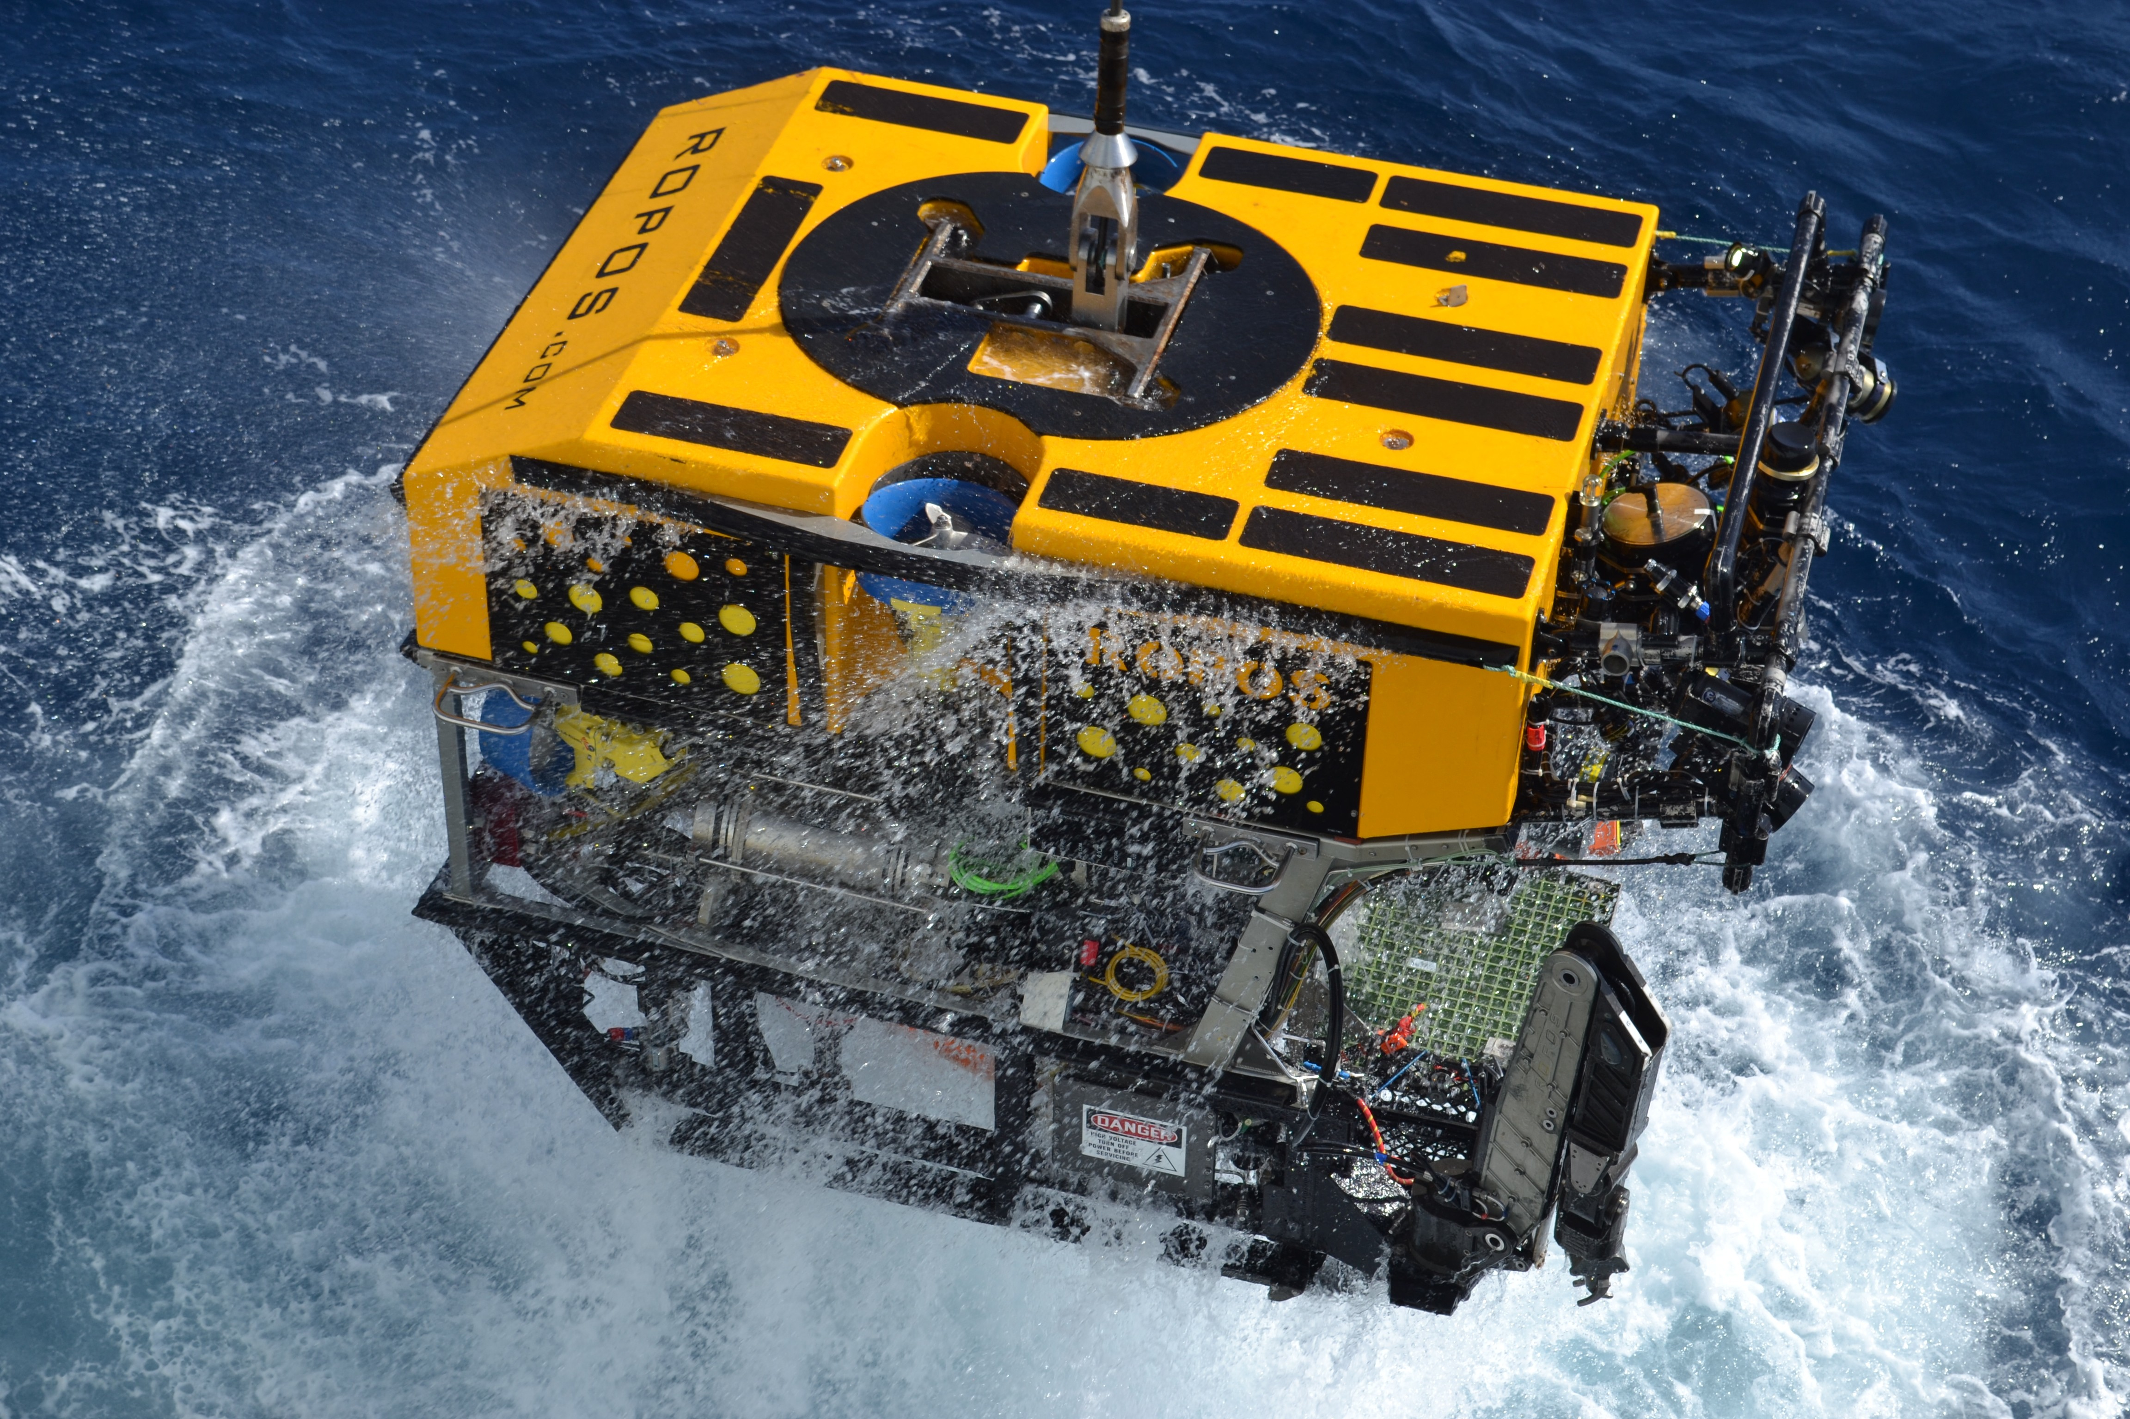
Introduction
Remotely Operated Vehicles (ROVs) have become indispensable tools for underwater exploration, surveillance, and inspection. These vehicles, operated from the surface by remote control, mitigate the risks associated with human presence in challenging and hazardous underwater environments. Our project focuses on the development of a hanging underwater/free-moving probe with a camera and various sensors, designed to aid maritime surface platforms, particularly addressing challenges posed in underwater search and surveillance.
This Photo by Unknown Author is licensed under CC BY-NC-ND
Notes:
© Copyright Showeet.com – Free PowerPoint Templates

Slide 6
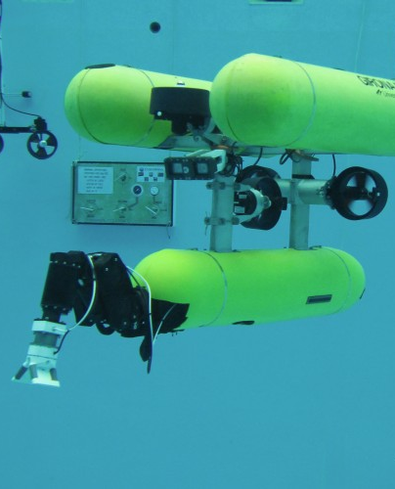
Problem statement
.Current keel inspection methods lack precision and endanger human safety.
Shipyard companies, ports, and maritime security lack a dedicated tool for precise underwater exploration and surveillance.
Absence of a versatile hanging underwater probe hinders keel inspections, search operations, and aquaculture monitoring.
Project goal: Develop a Hanging Underwater Probe with advanced sensors, meeting specific specifications to enhance maritime operational efficiency.
This Photo by Unknown Author is licensed under CC BY-NC-ND
Notes:
© Copyright Showeet.com – Free PowerPoint Templates

Slide 7
Literature Survey
Extensive research in the field of underwater robotics highlights the significance of ROVs in marine applications. Previous studies emphasize the need for efficient underwater vehicles for tasks such as keel maintenance, search and rescue operations, and aquaculture monitoring. Existing literature outlines the importance of integrating advanced sensors, camera systems, and safety features into ROVs for enhanced functionality and successful deployment in various maritime scenarios.

Slide 8
Literature Survey
S.NO | TITLE OF THE JOURNAL | PUBLISHERS NAME | YEAR | AUTHORS NAME
01 | SPH-DEM modeling of cable-controlled ROVs: Underwater mobility and path planning | Research Gate | 2023 | Zhengyang Su a b c, Yan Xiang a, Dianqing Li b c, Shun Wang b c, Jinbao Sheng a
02 | Monitoring marine fishes using underwater video techniques in the Mediterranean Sea | Springer | 2023 | Melina Nalmpanti, Anna Chrysafi, Jessica J. Meeuwig & Athanassios C. Tsikliras
03 | Total Design in the Design and Development Process of a Remotely Operated Vehicle (ROV) with Particular Consideration of Sensorization | MDPI SENSORS | 2022 | by Teresa Ramos ,Antonio Córdoba ,Amalia Luque andAna de las Heras

Slide 9
Literature Survey
S.NO | TITLE OF THE JOURNAL | PUBLISHERS NAME | YEAR | AUTHORS NAME
03 | Offshore inspection mission modelling for an ASV/ROV system | sciencedirect | 2022 | Chenyu Zhao ª, Philipp R. Thies ª, Lars Johanning ª ^{b}
04 | Remotely Operated Underwater Vehicle | FIU | 2013 | Gabriel Martos Ashley Abreu Sahivy Gonzalez
05 | Integration of ROV and vision-based underwater inspection for Limnoperna fortunei in water conveyance structure | sciencedirect | 2023 | Xin Fang , Heng Li , Sherong Zhang , Jikang Zhang , Chao Wang , Xiaohua Wang , Ziao Ma , He Jia

Slide 10
EXISTING AND PROPOSED SYSTEM
PROPOSED SYSTEM
EXISTING SYSTEM
Inspecting the keel for damage is an important part of ship maintenance. A thorough inspection should be carried out regularly to identify any signs of wear and tear or structural issues. This can be done by trained professionals who are familiar with the keel’s construction and materials
Underwater Remotely Operated Vehicles (ROVs) are invaluable tools that have revolutionized underwater exploration, research, and industrial operations. Their advanced technology, versatility, and ability to operate in extreme conditions have expanded our understanding of the oceans and their ecosystems

Slide 11
Work Plan
Our work plan is structured to cover the design, development, testing, and deployment phases of the hanging underwater probe. Key milestones include:
System Design and Specification
Hardware and Software Development
Prototype Testing in Controlled Environments
Underwater Testing and Validation
System Optimization and Refinement

Slide 12
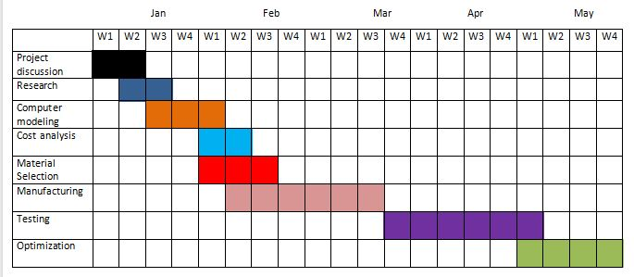
timeline:

Slide 13
Division of Task
TASK | TEAM MEMBERS | Hours spent
Camera | MANAVENDRA | 8
Propulsion&Solid works Analysis | SHANMUGANATHAN | 48
Structural Design | SHANMUGANATHAN | 30
Proposed Design | VENKATESH | 70
Wiring / controller | MANAVENDRA | 45
Video display | VENKATESH | 8
Testing and Analysis | ALL | 30
Optimization | ALL | 20

Slide 14
Outcome of the Project:
Upon successful completion of the project, the hanging underwater probe is expected to:
Enhance underwater inspection capabilities for shipyards and ports, particularly in keel quality assessments.
Facilitate the Indian Coast Guard in underwater search operations for bodies, debris, and vessels.
Provide a tool for monitoring aquaculture water quality and inspecting cage netting through load sensors.
Contribute to maritime safety by offering a versatile device for underwater surveillance and inspecting fittings.

Slide 15
References
https://doi.org/10.1109/ICONSTEM56934.2023.10142659
https://mme.fiu.edu/wp-content/uploads/2013/12/F13-SR-T-1.pdf
Systematic analysis of application challenges with ROV components | IEEE Conference Publication | IEEE Xplore
A ROV-Based Technology for Integrated Study of Deep-Sea Ecosystems | Request PDF (researchgate.net)
Electrical and Electronic Architecture of an ROV | IEEE Conference Publication | IEEE Xplore
Sensors | Free Full-Text | Total Design in the Design and Development Process of a Remotely Operated Vehicle (ROV) with Particular Consideration of Sensorization (mdpi.com)

Slide 16
References
A Technology Report From ROV '91 (dtic.mil)
ROV Teleoperation based on Sensory Augmentation and Digital Twins | OTC Offshore Technology Conference | OnePetro
Design and Construction of an ROV for Underwater Exploration (semanticscholar.org)

Slide 17

THANK YOU

